Slide 1


Merging and Solving conflicts

Slide 2

Solving Conflicts
A conflict happens when the remote repository contains different work than the local.
Changes on the same lines than our local repository are likely to have conflicts that GIT won’t be able to solve by itself.
In that case, you will need to specify which piece of code is the relevant one.
To that action is called solving conflicts.

Slide 3
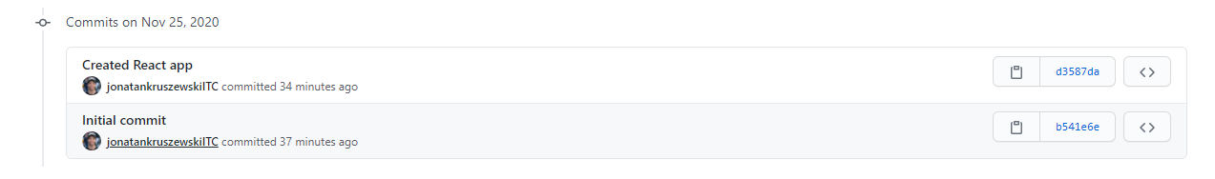
Solving Conflicts
Let’s give it a look.
We have a repository on a remote which looks like this:
Repository contains 2 commits.
Afterwards cloning, we will have the same ones in our local computer:

Slide 4
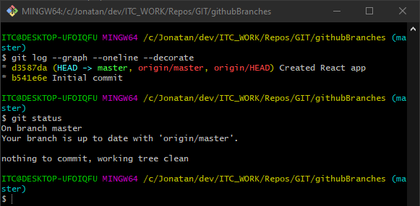
Solving Conflicts
In our local computer, looks the same:
We can run:
git log
And check that our master branch is on the same commit that origin/master or run:
git status
And check that our branch is up to date with the remote’s.
Both branches, remote and local have the HEAD on the same commit

Slide 5
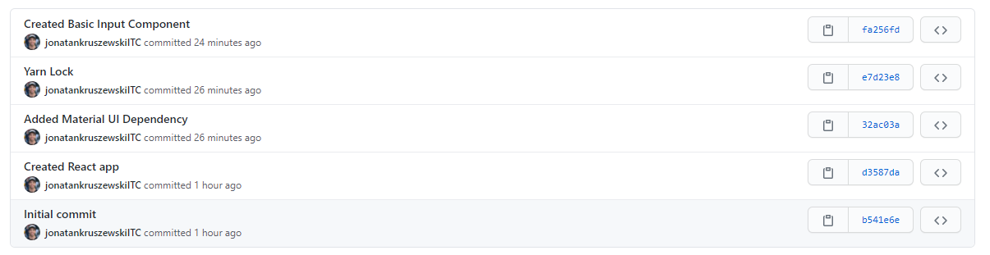
Solving Conflicts
But someone (me from other location to emulate other coworker in this case) has kept on working and pushed the code to the master (maybe after a pull request)
The point is that:
The master branch in the remote moved forward!

Slide 6
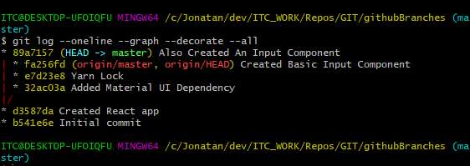
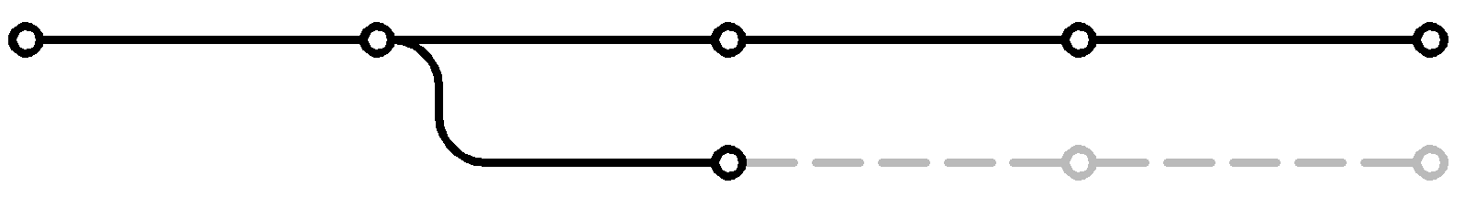
Solving Conflicts
As well as our local work:
As shown, in our project the commits that follows d3587da is 89a7157, while in the remote is the 32ac03a.
The history bifurcated at d3587da. There are 2 branches that contain different work
d3587da
32ac03a
origin/main
local/main
89a7157

Slide 7
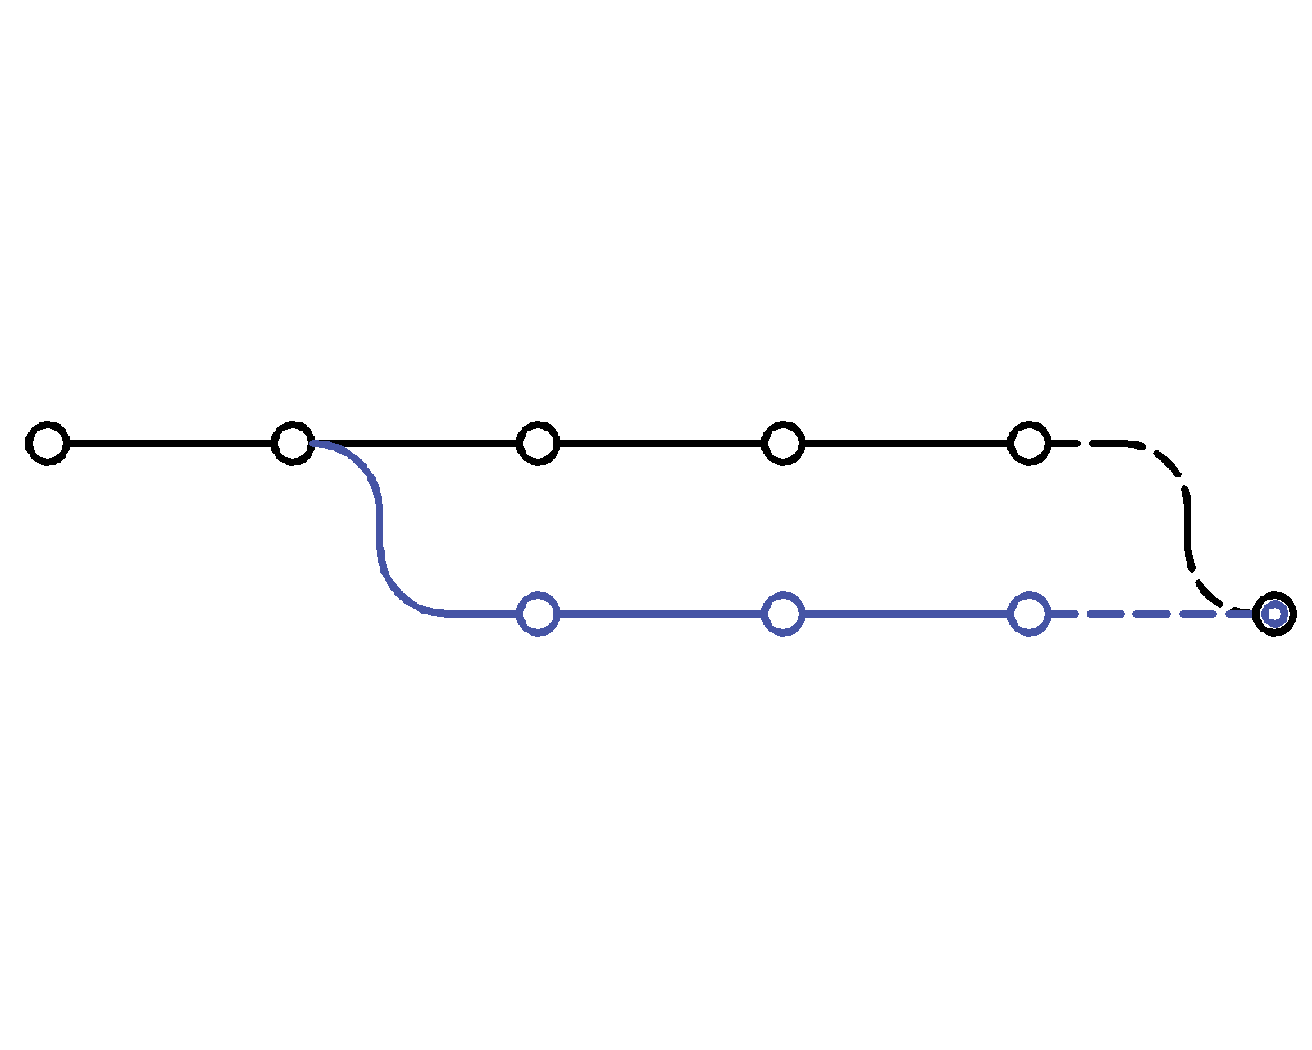
Solving Conflicts
The histories at this point have bifurcated:

Slide 8
Solving Conflicts
And at some point we will need to merge them:
New commit with 2 ancestors
To create the new commit we will need to ‘merge’ origin/main into local/main, solve conflicts, and commit.

Slide 9
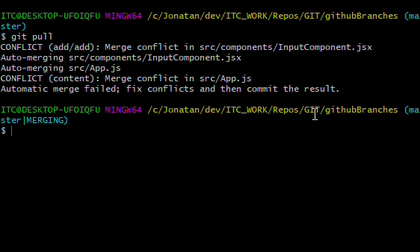
Solving Conflicts
Since we have different histories, when we pull… we have conflicts to solve!
Some parts of the files GIT was able to auto-merge. Amazing! But still, InputComponent.jsx and App.jsx need to have those conflicts solved.
But others… Can’t tell which one is the proper one.
Notice that our branch gets a MERGING note too.

Slide 10
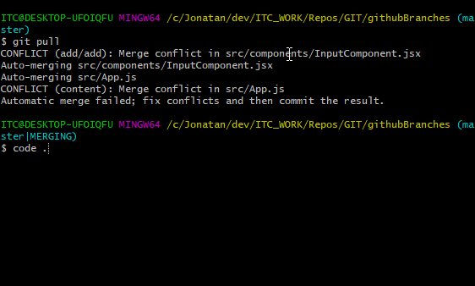
Solving Conflicts
We can still perform commands while merging:
code .
That will open VSC. Let’s solve the conflicts from VSC UI.

Slide 11
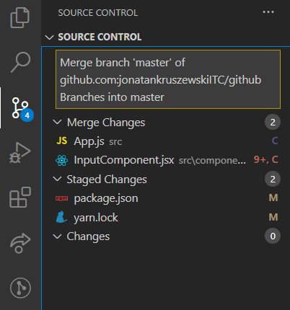
Solving Conflicts
On VSC in the source control we can see the files that have conflicts under the Merge Changes:
App.js
InputComponent.jsx
The C next to them indicates that they have conflicts.
Let’s open both files:

Slide 12
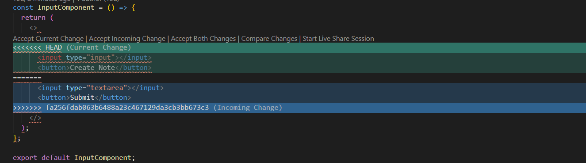
Solving Conflicts
When you open one of the files, it will look something like this:
Where the differences between the local and the remote gets highlighted in different colors. We will need to pick which version do we want to keep

Slide 13
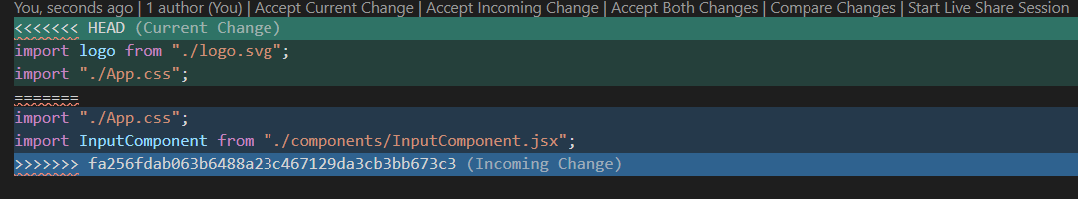
Solving Conflicts
For example, in App.js, we want to accept the ‘Incoming’ Change
Every time there is a conflict, the GIT integrated tool will show us the differences between the 2 files.
We will need to pick what we want (Accept Incoming - Accept Current, or both).
In this case, we want the Incoming one.
Let’s keep on solving conflicts until there are none of them

Slide 14
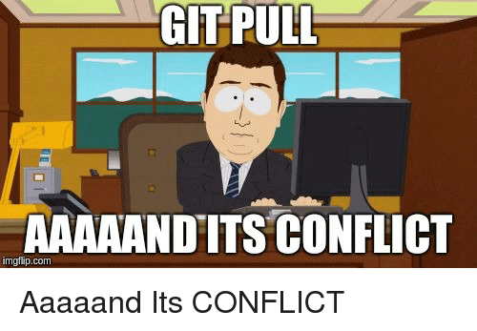
Solving Conflicts
This is the point where you realize that doing small commits and pulling often is better than doing large commits and not pulling that often.
🤓

Slide 15
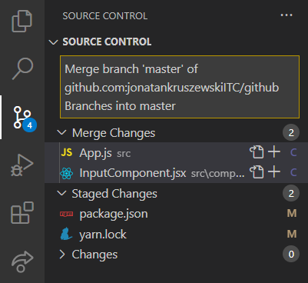
Solving Conflicts
Once you finish going over all the changes, let’s stage them:
You will notice that when you finish solving conflicts, the files will show only a C (conflicts) but not the number of lines to fix (since there are none). The C will be in purple instead of red.
To add this two files, we can run:
git add .
Or stage them clicking on the plus next to their name.

Slide 16
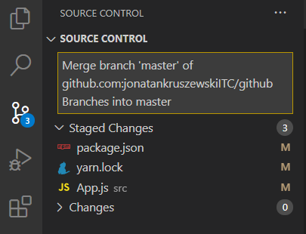
Solving Conflicts
After staging, you will see your files that you fixed in the staging area:
The reason why inputComponent.jsx is not staged is because… we kept the local changes!
So nothing to stage and commit!
But on App.js we accepted incoming ones, so that file will be moved to the staged area.

Slide 17
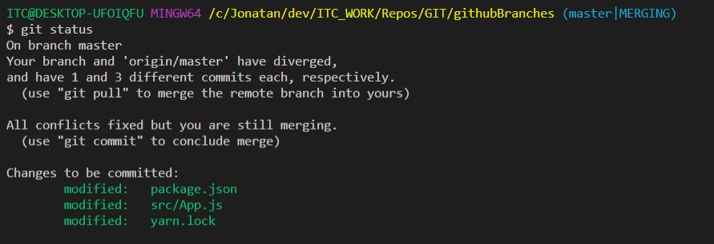
Solving Conflicts
If we run git status while merging we will see:

Slide 18
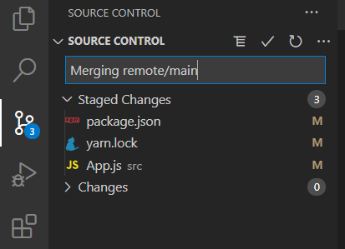
Solving Conflicts
Let’s update the message for something more useful:
The reason why inputComponent.jsx is not staged is because… we kept the local changes!
So nothing to stage and commit!
But on App.js we accepted incoming ones, so that file will be moved to the staged area.

Slide 19
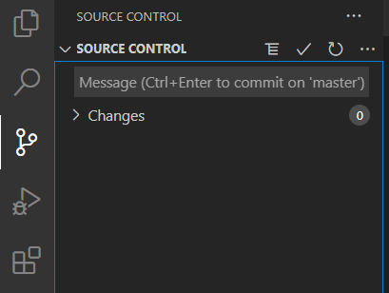
Solving Conflicts
Afterwards creating the commit:
Working area clean

Slide 20
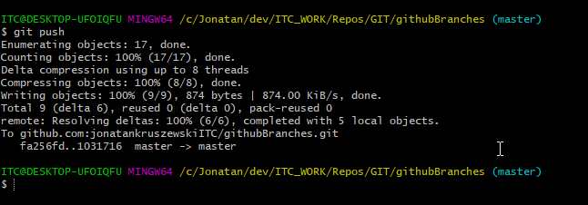
Solving Conflicts
Back in the terminal, we will be able to push:

Slide 21
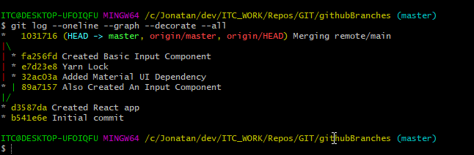
Solving Conflicts
If we inspect with git log --oneline --all --decorate --graph we will see the branching as well as the merge at the commit 1031716:

Slide 22
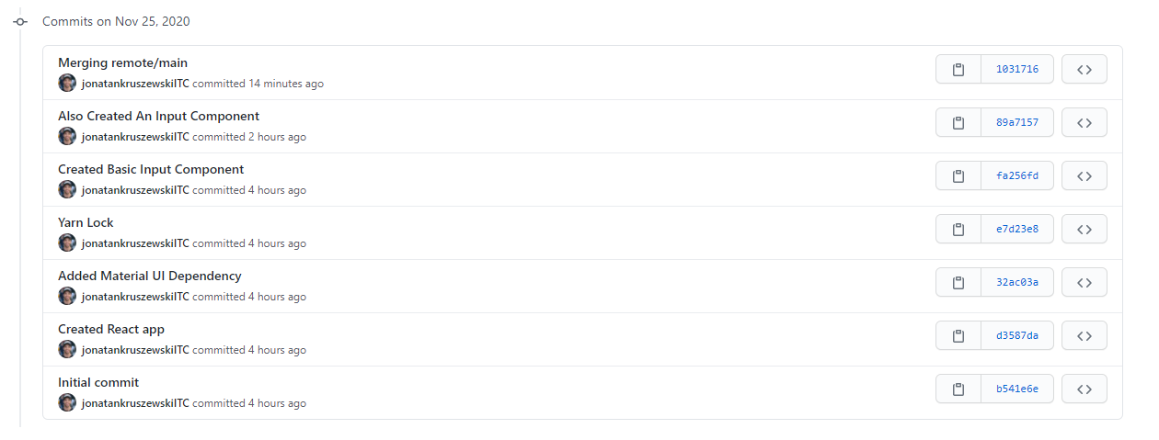
Solving Conflicts
As well as in the remote:
That’s it 😎

